Slide 1
Increasing operational efficiency and fraud detection in automobile insurance claims using Gen AI
Sprint 2
Team 13 & 14

Slide 2
Agenda
1
Completed Tasks
2
Project Pipeline
3
Progress Updates on Ongoing Tasks
4
Roadblocks
5
What’s Next

Slide 3

1
Completed Tasks
Notes:
Completed Feasibility Report

Slide 4
Completed Tasks
Completed Tasks - Data Team
Completed Tasks - AI Team
Built High Level Solution Design
Refined Options Analysis and settled on solution approach
Found data sources and identified relevant features
Defined database schema
Experimented with python scripts to establish proof of concept

Slide 5
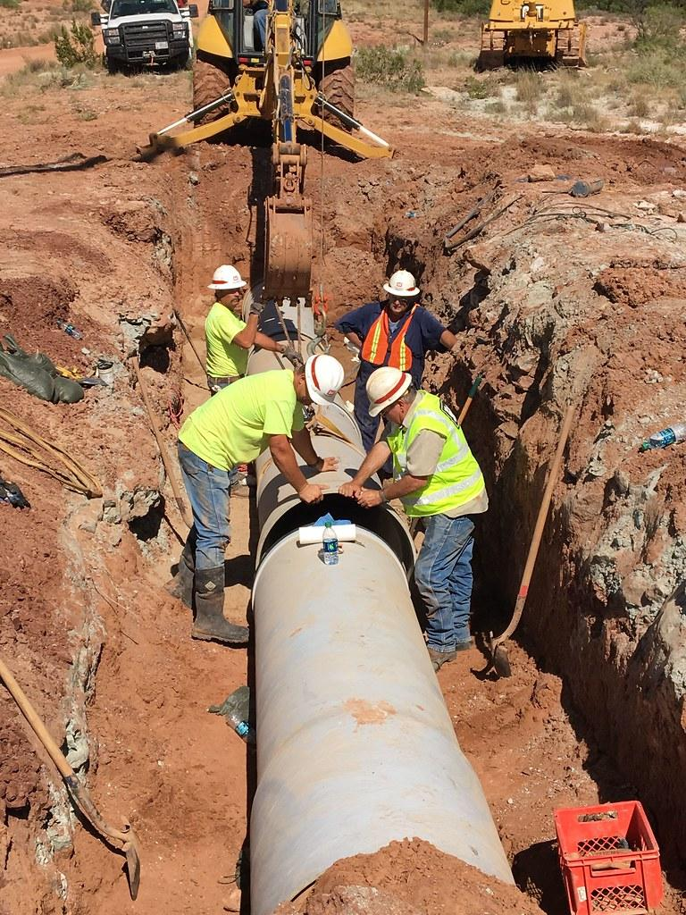
2
Project Pipeline
Notes:
Completed Feasibility Report

Slide 6
Combined Project Pipeline
Gantt Chart

Slide 7
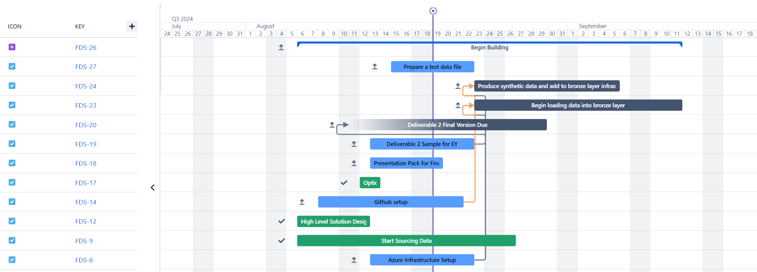
Project Pipeline - Data Team

Slide 8
Combined Options Analysis - 1
 | Feasibility | Cost
OPTION 1: Data Team: Azure Data Lake Storage Gen2 REST API and Azure Function AI Team: | Cost-effective: more cost-effective for small/medium workloads. Simplicity & Speed: Azure Functions are easier to set up and deploy → faster development time Scalability Limits: upper timeout durations of 10 minutes thus, issue when our dataset grows Cold Latency Starts: AF is serverless thus, will introduce latency due to cold starts → affect performance | Azure Data Lake: $0.44745/month Azure Functions: The first 400,000 GB/s and 1,000,000 executions are free Per month total: $0.45
TOTAL OPTION COST
Notes:
After much discussion, our team picked azure functions for this project and data with be stores in data lake gen 2. Structurally wise there has been no change except that we have removed the use of data factory to orchestrate the data pipeline.
Each 1,000,000 executions more is $0.31
Functions
(128MB, 3 min execution time, 17,777 executions free) | 20,000 executions $ 1.22
Data lake -
Storage - First 51,200 GB / month - $0.031 per GB
Write operations - $0.10942 (every 4 MB, per 10,000)
Read operations - $0.00874 (every 4 MB, per 10,000)

Slide 9
Combined Options Analysis - 2
 | Feasibility | Cost
OPTION 1: Data Team: Azure Data Lake Storage Gen2 REST API and Azure Function AI Team: | Cost-effective: more cost-effective for small/medium workloads. Simplicity & Speed: Azure Functions are easier to set up and deploy → faster development time Scalability Limits: upper timeout durations of 10 minutes thus, issue when our dataset grows Cold Latency Starts: AF is serverless thus, will introduce latency due to cold starts → affect performance | Azure Data Lake: $0.44745/month Azure Functions: The first 400,000 GB/s and 1,000,000 executions are free Per month total: $0.45
TOTAL OPTION COST

Slide 10

3
Progress Updates on Ongoing Tasks

Slide 11
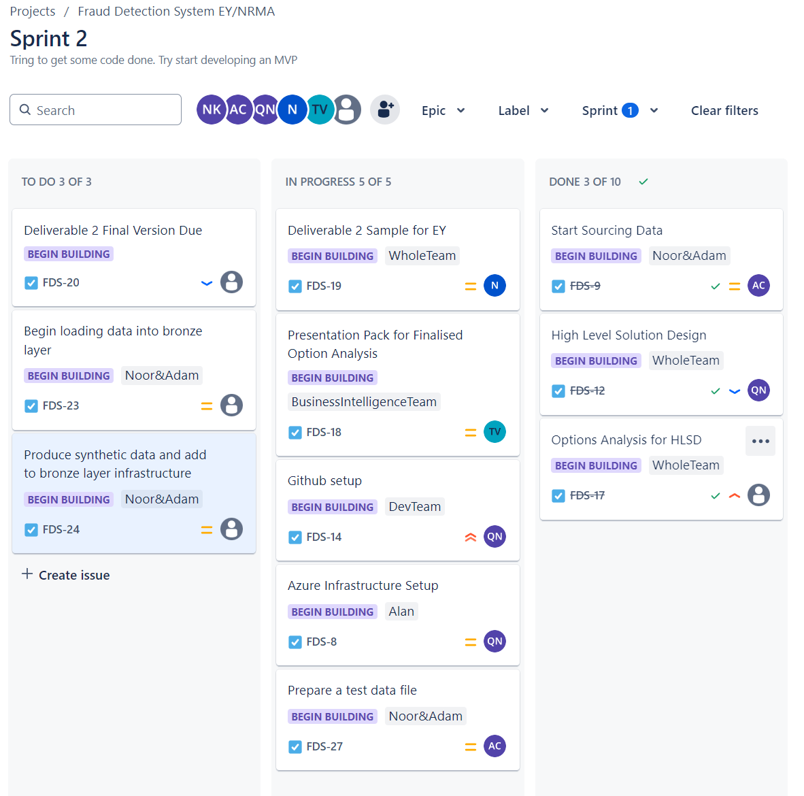
Data Team Tasks Overview
Main Planned & Ongoing Tasks:
Deliverable 2 Assignment for University
Github Setup
Azure Infrastructure Setup
Producing synthetic data
Sourcing data consistent to predefined schema

Slide 12
AI Team Tasks Overview

Slide 13

4
Roadblocks

Slide 14
Roadblocks
Roadblocks
Sourcing data that is consistent with our dataset schema.
Designing the GitHub repository turned out to be more complex than we originally anticipated.
Determining optimal methods for synthesising data.
Optimising our Azure infrastructure.
Code convention and organisation implementations
Notes:
Github repository - Hoping to ask Noah about this
Synthesising data - so many options that we are trying to decide from (we have three methods right now)
We are still trying to figure out the metrics
Skit learn
GAN - basically a neural network which can learn and replicate data
Using OpenAI’s Codex to try replicate trends in source data
Our core services will be Azure Functions , Data Lake Storage
however, there are more services that might be more beneficial. We are still brainstorming over these extra services. - always considering costs!

Slide 15
Thank You

